Slide 1


University Of Bourgogne
Project On
RGB-D Object Detection
Supervised by : Zongwei Wu
Thibault Clamens
Presented by: Abdul Muizz Bin Abdul Jalil
Divine Bakala

Slide 2
Content
Introduction
Related Work
Our Model
Implementation
Discussion
Conclusion

Slide 3
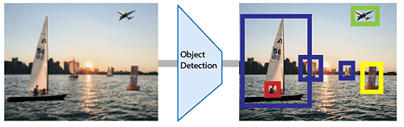
Introduction
To detect grapes using RGB-D object detection.
RGD-D object detection aims at distinguishing the most visually distinctive objects or regions in a scene from the given RGB and Depth data.

Slide 4
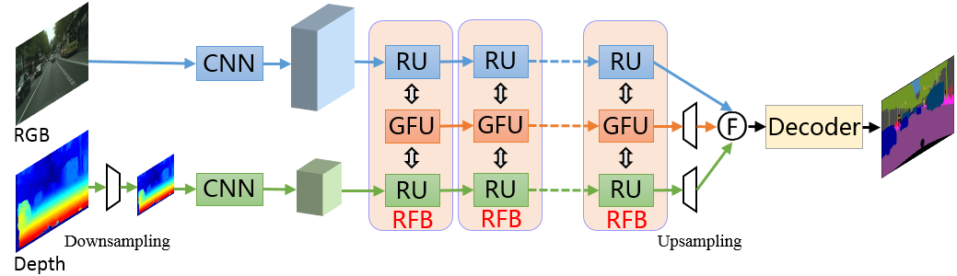
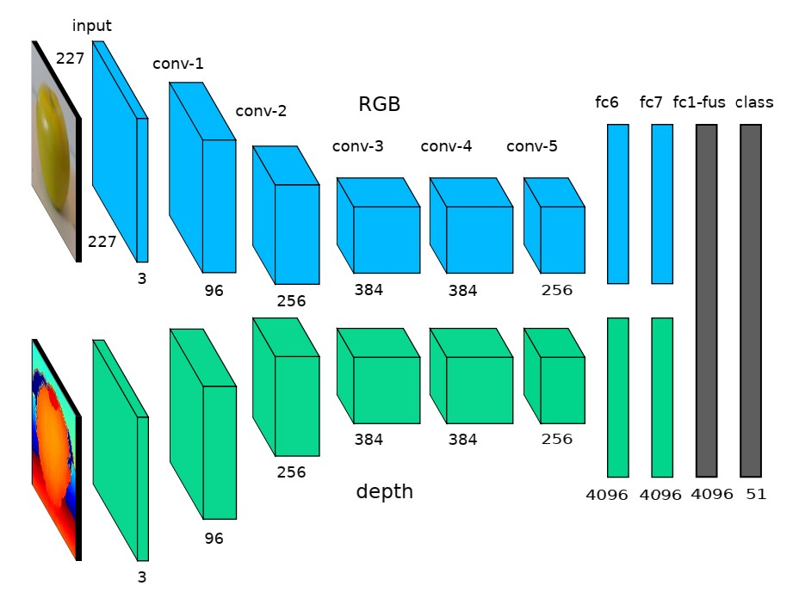
Related Work
Different methods of RGB-D object detection

Slide 5
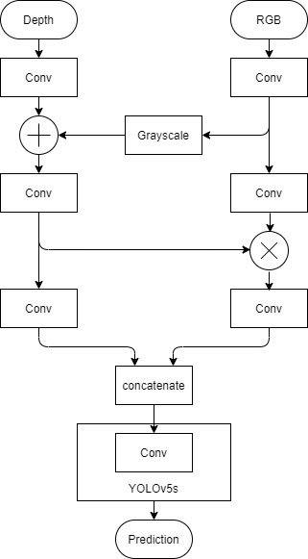
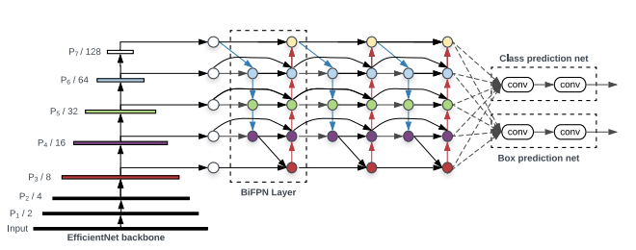
Our Model
Model

Slide 6
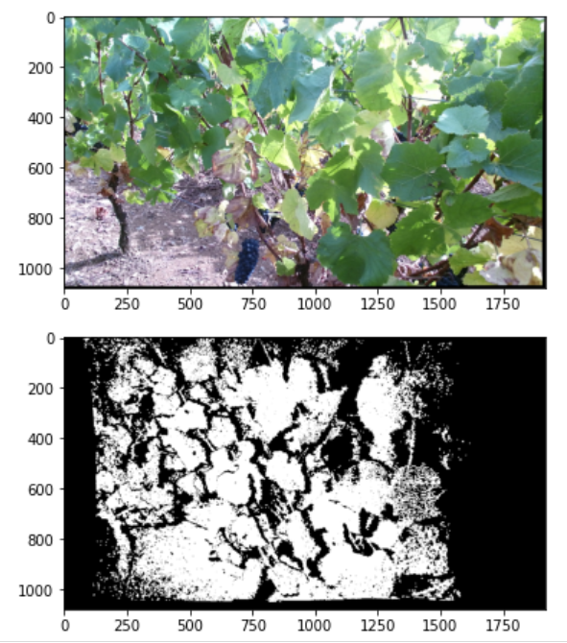
Input Images

Slide 7
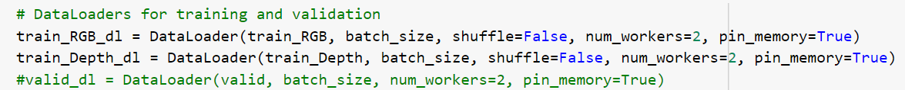
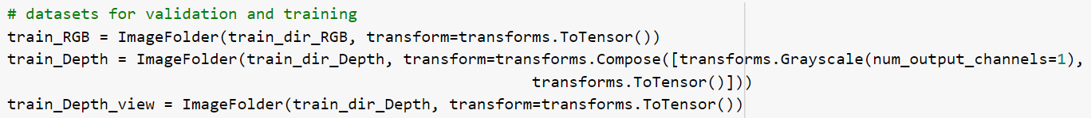
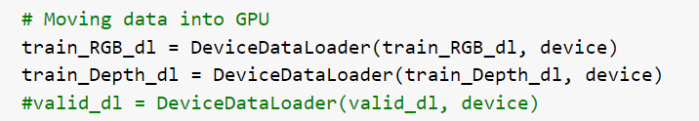
Implementations

Slide 8
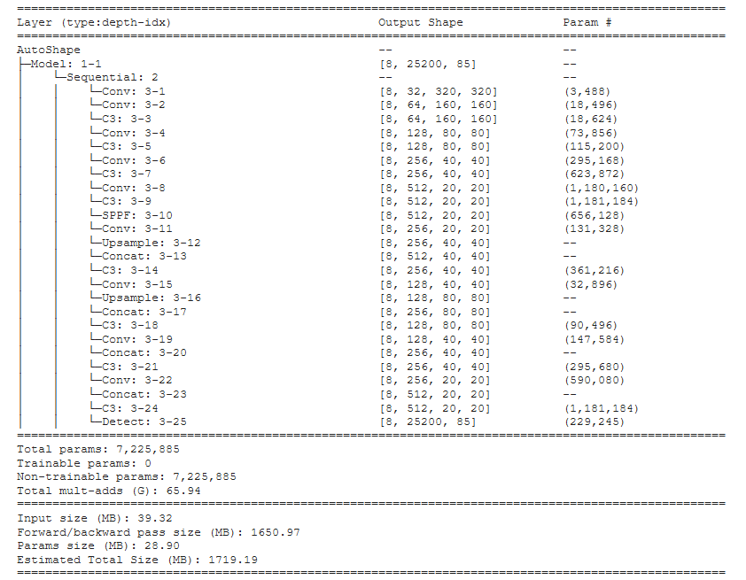
Implementations
Yolov5s layers

Slide 9
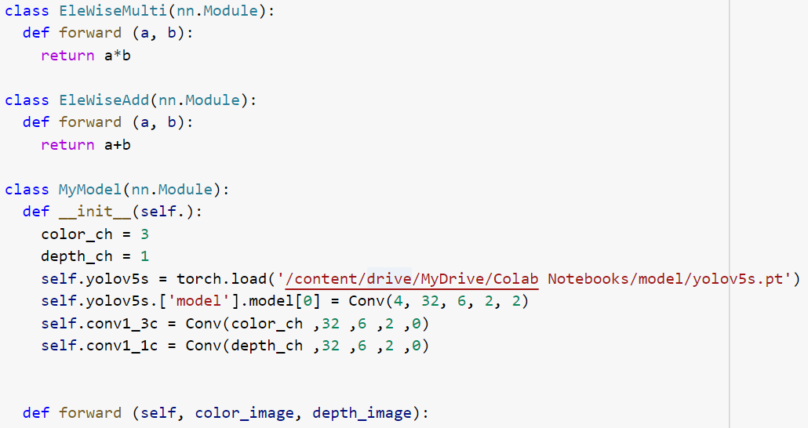
Implementations

Slide 10
Discussion
It takes time to modify the YOLOv5 model.
To change the first and last layers can replace with new layer.
Since it process as tensors, so every things have certain shapes and size.
We also find that by using class to create custom layers using pytorch framework.
Since it operates as sequantial for every tensors, it can be add or replace with new and custom layers.

Slide 11
Conclusion
So we try to propose a late fusion model to give better detection but did not know the performance

Slide 12
Thank You For Your Attention!

